Slide 1

CS 6475 Final Project: Video Stabilization
Thanh Le
Fall 2020
This project is based on "Auto-directed Video Stabilization with Robust L1 Optimal Camera Paths", by Matthias Grundmann, Vivek Kwatra, and Irfan Essa

Slide 2
Project Goal
What was your original project scope?
The scope of this project is to develop an algorithm to that stabilize videos by removing undesired motions. Post-process video stabilization has three main steps:
Camera Motion – Estimate the original (shaky) camera path of the video
Path Stabilization – Estimate a new smooth camera path via Linear Programming
Cropping – Synthesize the stabilized video using the estimated smooth camera path
What motivated you to choose this project?
I chose this project because I felt I could leverage code from previous assignments such as A3 – Panoramas and A5 – Video Texture. There is also a module on this topic, 06-03 Video Stabilization, on Canvas. This made the research paper easier to digest compared to the other research papers.

Slide 3
Scope Changes
Did you run into issues that required you to change project scope? If yes, give a detailed explanation of what changed. If no, say so.
I ran out of time before I could investigate adding a saliency constraint for the optimal camera path. This would perform directed video stabilization. This feature requires a significant amount of changes to the base stabilization code and there is no guarantee I would be able to successfully implement the feature. Thus I didn’t include it in my scope.

Slide 4
Demonstration of Original Result Sets
1. Demonstrate at least three complete result sets. If your results can easily be shown here in your slides, please do. Explain in detail what you are showing.
Label each input/result set (ex: Set 1)
2. Provide a WORKING link to your main directory here in the report. All resources (individual videos, gifs, image sets, etc.) must be hosted under one main directory on GT Box. Detailed instructions are in the project's README on GitHub. If we cannot access your resources separately, there will be deductions.
GT Box: https://gatech.box.com/s/h97a2tm7d2ycz19plw9wsedqmkan8fy7
- Readme.txt
- Input 1, Input 2, and Input 3 (original shaky videos)
- Result 1, Result 2, and Result 3 (stabilized videos, motion plots, and frames)
- Skater original, and Skater stabilized videos
- Fail outputs

Slide 5
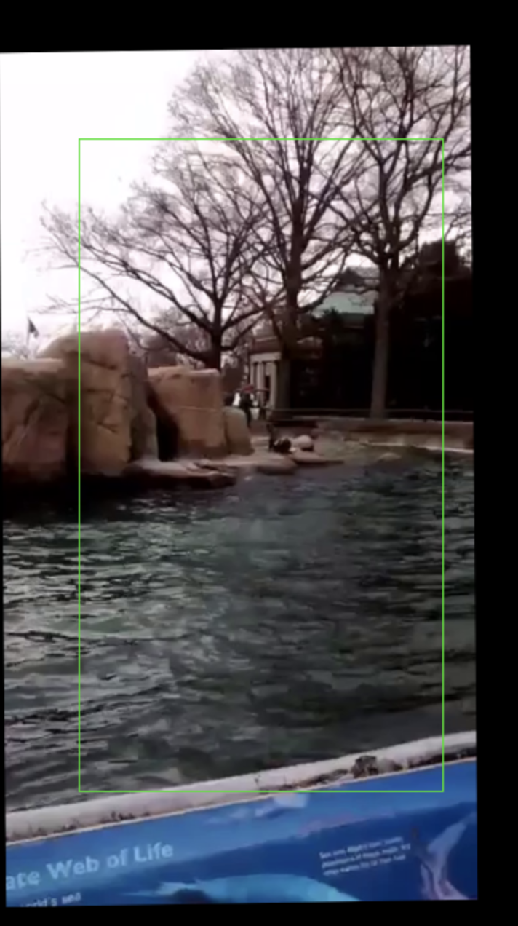
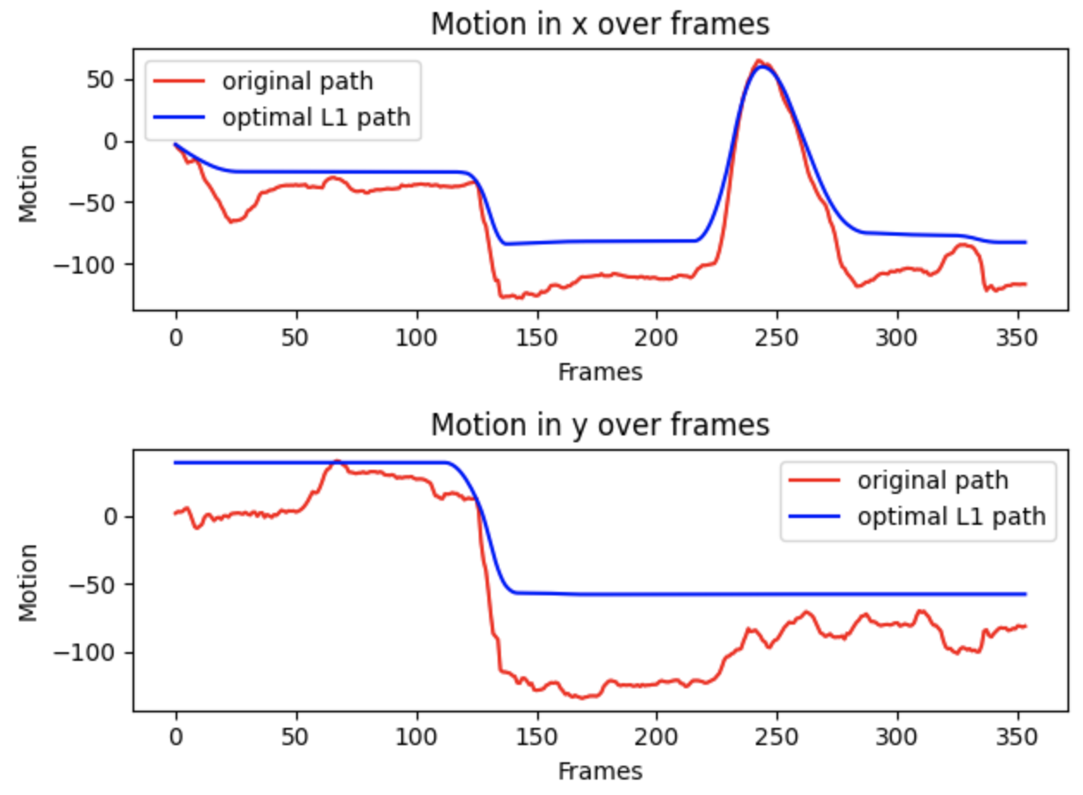
Result 1: Seal
Original video: https://gatech.box.com/s/3m5tj151cuyz5ezviqv3cu2bq87khvv0
Output video: https://gatech.box.com/s/3kvhexf3jlke56mawnlk4tmsvokoglbh
Description: This video was taken a few years ago at the Central Park Zoo. The focus of this video are the seals.
Comment: I am satisfied with the final output of this video. It is much more stabilize than the original video. The optimal path is very close and smooth compare to the original path of the camera.
Motion plots for Result 1 video
Frame0001.png - The first frame of the video after transformation was applied

Slide 6
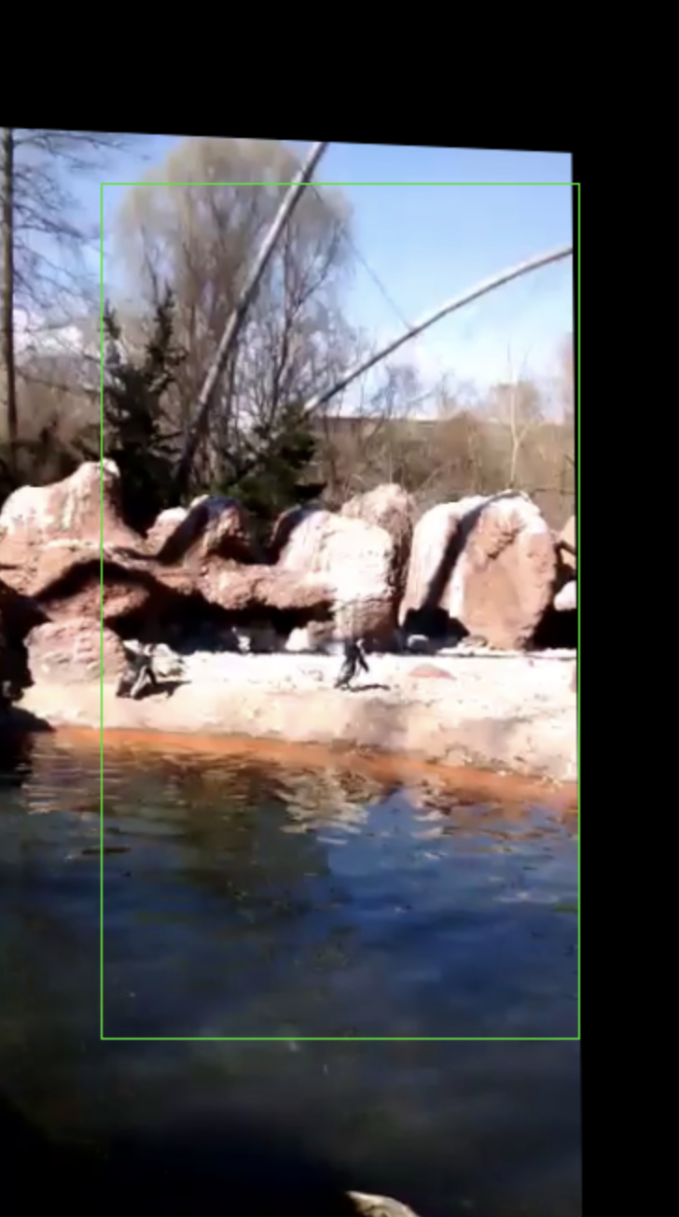
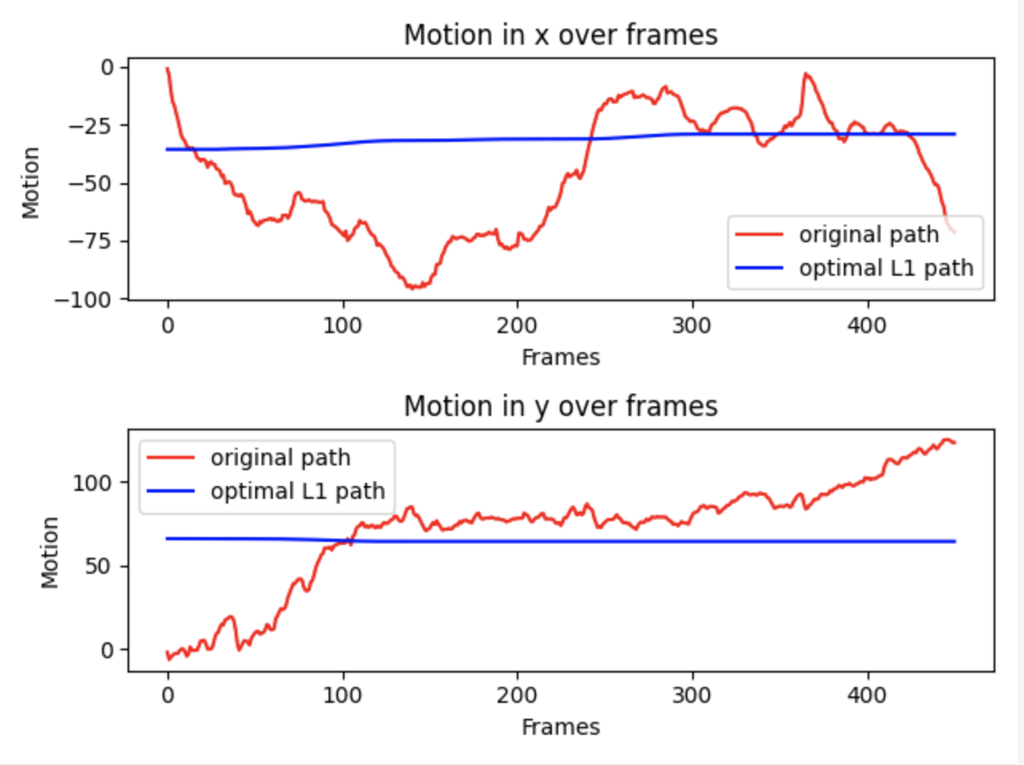
Result 2: Penguins
Original video: https://gatech.box.com/s/ia40q5hp6kyf24tl9k9uwz9ahm1q924v
Output video: https://gatech.box.com/s/ujptbb8jgt1bzgvr3y434ca78vwv7xl8
Description: This video was taken a few years ago at the Central Park Zoo. The focus of this video are the penguins.
Comment: The final video is less shaky than the original video, however, the background is still a bit wobbly. The optimal path is not the best, it doesn't closely follow original camera path.
Motion plots for Result 2 video
Frame0001.png - The first frame of the video after transformation was applied

Slide 7
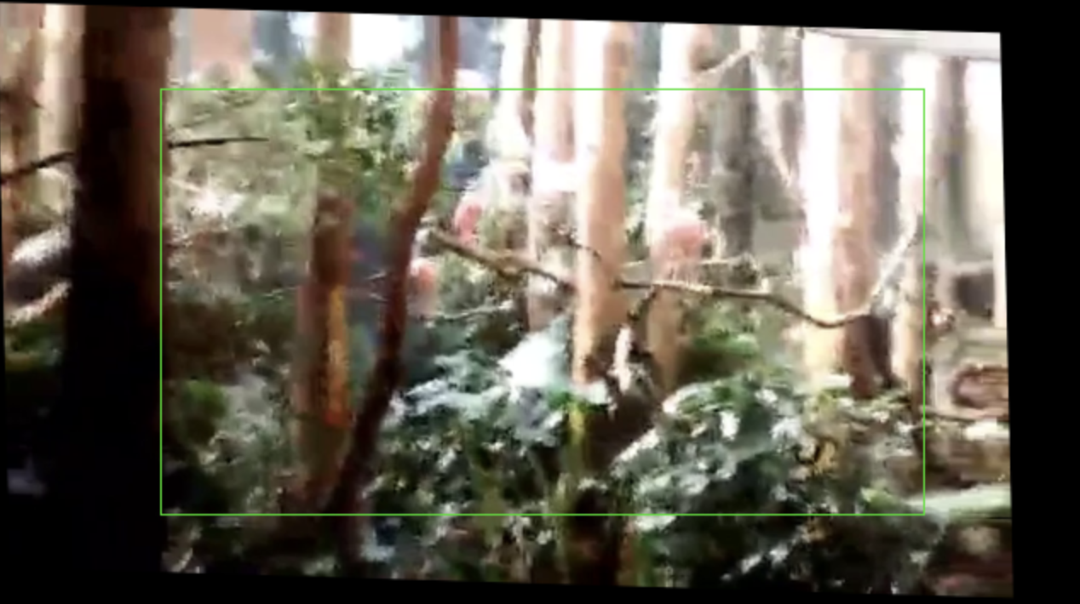
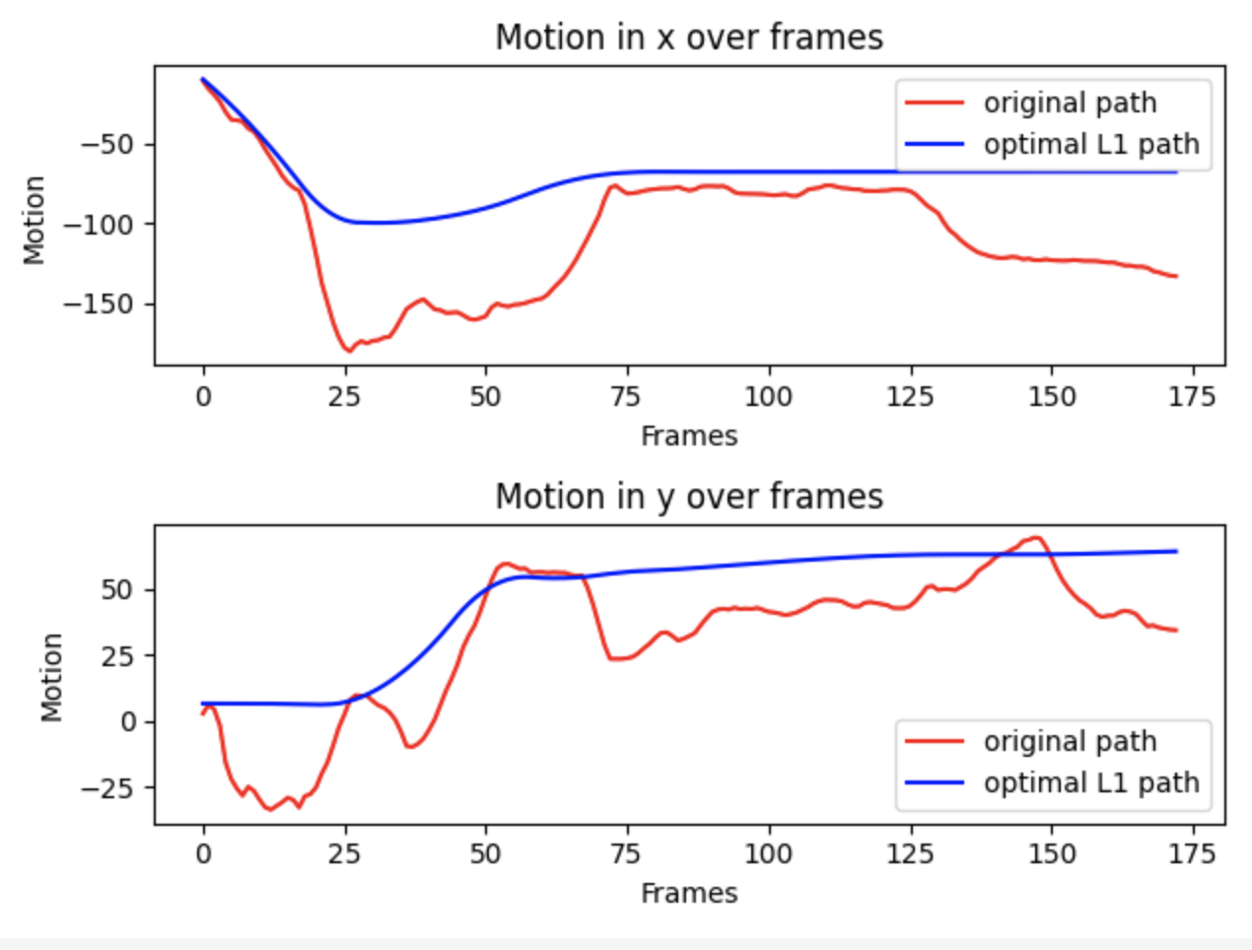
Result 3: Birds
Original video: https://gatech.box.com/s/r2exes3pbplzl6hd5set1x6jlff2ccej
Output video: https://gatech.box.com/s/j2sb24fxbat8tr442tpns1ryq7rzq5rr
Description: This video was taken a few years ago at the Central Park Zoo. The focus of this video are the pink birds.
Comment: I am satisfied with the final output of this video. It is much more stabilize than the original video. The optimal path is very close and smooth compare to the original path of the camera.
Frame0001.png - The first frame of the video after transformation was applied
Motion plots for Result 3 video

Slide 8
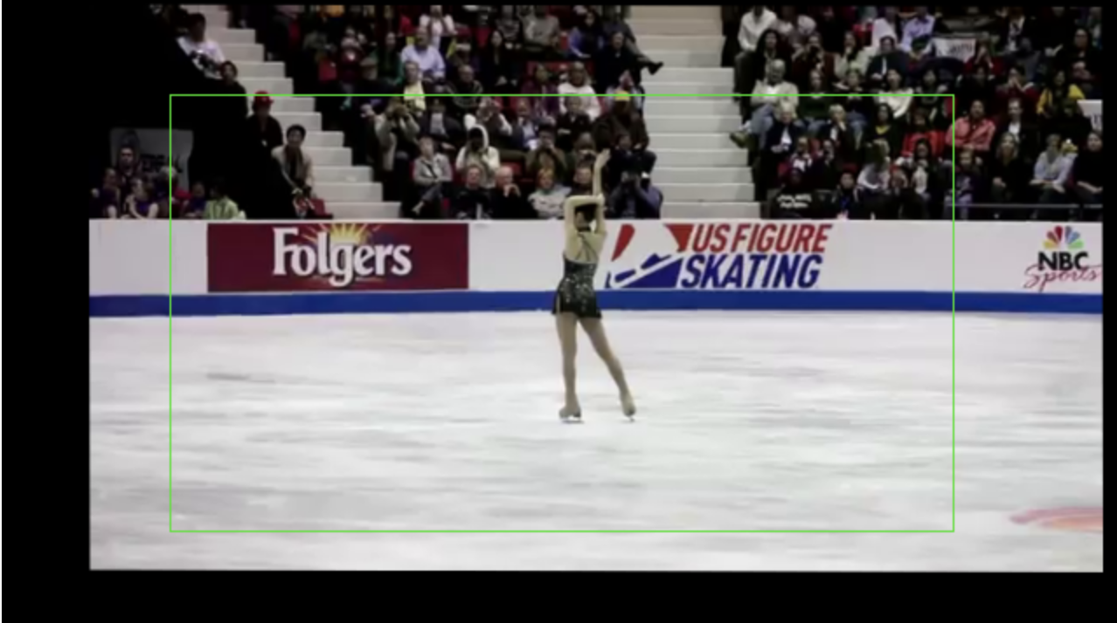
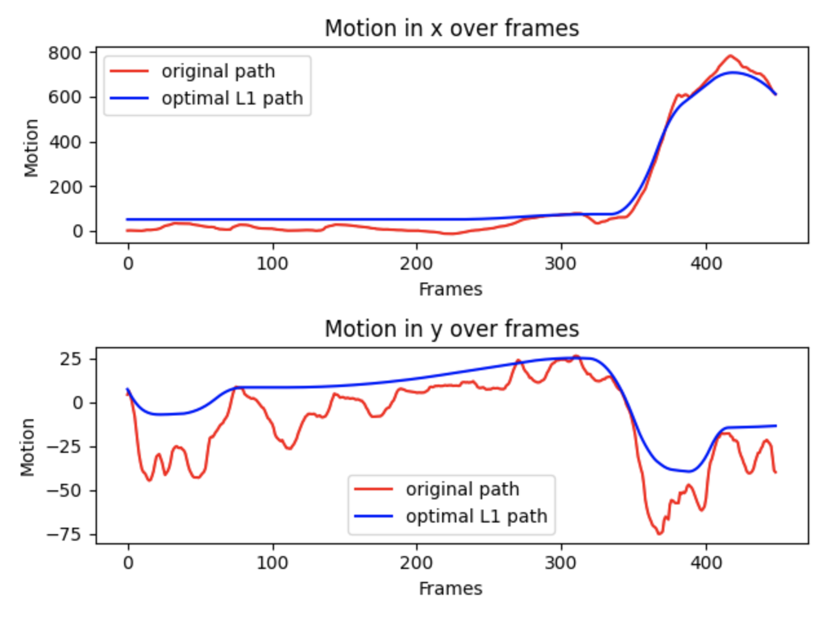
YouTube: Skater
Original video: https://gatech.box.com/s/zgr81aqhe1wzp3mhkrdbz3z6hezwcn9v
Output video: https://gatech.box.com/s/9xlr59gbg0qmnsla1utop6ujv8nwu4ad
Description: This video is from YouTube. The focus of of video is the skater in the center.
Comment: This video was used in the paper. I am satisfied with the final output of this video. It is much more stabilize than the original video. The optimal path is very close and smooth compare to the original path of the camera.
Frame0001.png - The first frame of the video after transformation was applied
Motion plots for the Skater video

Slide 9
Computational Pipeline
1. Input
Update the VIDEO variable in final_project.py
4. Extract keypoints and descriptors using cv2.ORB_create() and orb.detectAndCompute()
extractFeatures()
2. Convert video to frames using ffmpeg
video2frames()
3. Read and store frames
readImages()
7. Apply optimization to path using cv2.warpPerspective
applyStabilization()
6. Compute the optimal path using Linear Programming (CVXPY)
findOptimalPath()
5. Compute the original camera path
findCameraPath()
8. Convert transformed frames to video using ffmpeg
frames2video()
9. Plot the original and optimize motion paths
graphPaths()
Automatic
Output Video
Output Plots

Slide 10
Project Development
Setup:
Input video – During development of the code I simply used the skater video. I didn’t start thinking about what videos to use for input until after I had gotten applyStabilization() to somewhat work. I know I have shaky camera video in my archive, so I didn’t worry too much about creating original input video. I made the decision to prioritize speed over output quality, so all my input videos are less 480p resolution and about 10-15 second long.
video2frames() and frames2video() - I leveraged the information from A5-Video Texture assignment to write these functions. These functions main purpose is to convert video into frames and vice versa frames to video. The functions will automatically create a source directory and place the output there. From my experience in A5, I made this function a part of the main script so I wouldn’t have to go back and forth between the IDE and terminal to use ffmpeg. Thanks to this I saved a lot of time.
readImages() – The purpose of this function is to reads in input images from an image directory. This code is taken from A5-Video Textures assignment in the main.py file. I assume this is okay to do since this code was given for student to use in the previous assignment.

Slide 11
Project Development
Camera Motion:
extractFeatures() – Leveraged from Module 4 and 5 Demo Code – feature detection and feature matching. This function find the key points and descriptors with ORB detector for each frame. The demo code are for an outdated version of python and OpenCV, so I had a ton of errors when I tried to run it. Nonetheless, since the framework is already there it wasn’t difficult to find equivalent updated function. The demo code suggested the cv2.SIFT() function however this wasn’t working and caused the bunch of error. I ended up using cv2.ORB_create() function since it was much faster than the alterative cv2.SIFT_create() detector.
findCameraPath() – The paper didn’t explicitly explain how to do this but after looking at a few OpenCV tutorial on feature matching it was clear I needed to look for Affine Transformations between every two consecutive frames. Again, I leverage the Demo code and a few OpenCV tutorial to complete this function.

Slide 12
Project Development
Path Stabilization and Cropping
findOptimalPath() – Needless to say, this is the most important part of the project. Figuring out what to do from the research paper was not an easy task. I had to reread the paper more than 5 times and constantly referencing back for what to do next. I also looked at other research and reference material on Video Stabilization and L1 Optimal Camera Path to understand the equations and variables presented in the paper. I spend roughly 2 weeks on this section of the code alone. I didn’t know about Linear Programming, so I spend a few days trying to get a rough idea of what it is and how to solve optimization problem using it. Luckily, it wasn’t too bad and other students shared on Piazza and Slack that they used CVXPY library to accomplished this LP programming. Finally, I was able to follow the equations from section 2.1 and Algorithm 1 from the paper to set up the objective and constraints to calculate the optimal camera path.
graphPaths() – I simply extract the x and y values from the transformation matrix and plot them over the number of frames. I used Matplotlib library to plot my charts.
applyStabilization() – I have less than 2 days to work on this and thus I was not able to produce the best-looking results. The output videos are all less unsteady than their original counterpart, but they are still a bit wobbly. I suspect that I was not able to apply the translation properly onto the original frames. This function output two set of transformed frames. One set has a green rectangle on top and other set is a cropped version without the black border.

Slide 13
Project Development
2. Both good and failed interim results (from various parts of your work and pipeline).
The good interim result would be the skater video shown in previous slide. The code produced a very good optimal path, and the video is indeed less shaky than the original video. The graphPaths() function was written before the applyStabilization() function to help me visualize the optional path. I was ecstatic when I got the plots working.
I mixed up the frame’s width and height multiple time throughout the code and this caused a lot of errors. It took me a long time to debug the code to figure out that was the issue. One of the time was in the Inclusion Constraints in findOptimalPath() and another time was when I was working on the applyStabilization() function
I also kept getting “error: (-215:Assertion failed) (type == CV_8U && dtype == CV_32S) || dtype == CV_32F in function 'batchDistance' match”. In the beginning it was due to my environment not properly setup in Pycharm IDE. I also got a few other OpenCV errors due to this. Later, this turn out to be coming from the cv2.BFMatcher.match() function. The reason is because orb.detectAndCompute() was not able to find any key point or descriptor on a frame. After I got the skater video working, I tried to run the code with a video that I took from a concert. The video was apparently too dark, and the orb function was not able to find any features. I didn’t have time to further investigate. But I used this as a baseline and looked for videos I have that have lots of feature so I wouldn’t run into this situation again.
See GT Box (https://gatech.box.com/s/h97a2tm7d2ycz19plw9wsedqmkan8fy7) for fail results.

Slide 14
Project Development
3. What did you finish? What is not finished?
I finished all the steps in my computational pipeline. I still need more time to polish the extractFeatures(), findCameraPath(), and applyStabilization() functions. Currently the code will not work for video with few details. The extract features function will find no key points and descriptors and the code will fail at the find camera path function since no match will be found for that frame and its adjacent frame. I didn’t write any code to handle this and just output an error. The apply stabilization function is not 100% complete. I applied the transformation by calling cv2.warpPerspective but the final video is cropped based on the center points and crop ratio.
4. What would you do differently? Explain.
I didn’t have time to create shaky videos for my inputs. So I just looked through my phone history to find shaky video. The videos I used are from 2016 when I have a Motorola phone with no built-in stabilization video feature like my current Samsung Galaxy Note. Given more time I would had went outside and capture better input videos.
I would also like to make my code command line compatible. Currently user must go into the main file, final_project.py, to update the VIDEO variable which stores the name of the input video of interest before running the code. Making the code command line compatible would make it easier to run the code and take in user arguments.

Slide 15
Computation: Discussion of Code Functions
Walk through your code functions. You MUST:
Show and discuss code snippets. Explain the purpose of the code that you are presenting.
Explain the major algorithms. If you used them, show that you understand them in your own words. Do NOT copy from the technical papers.

Slide 16
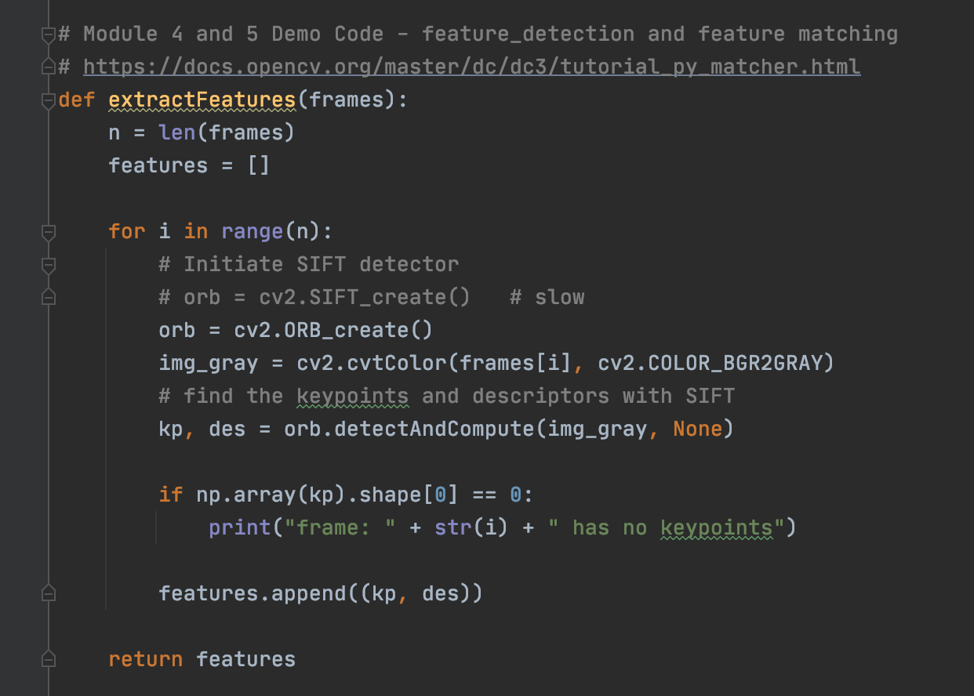
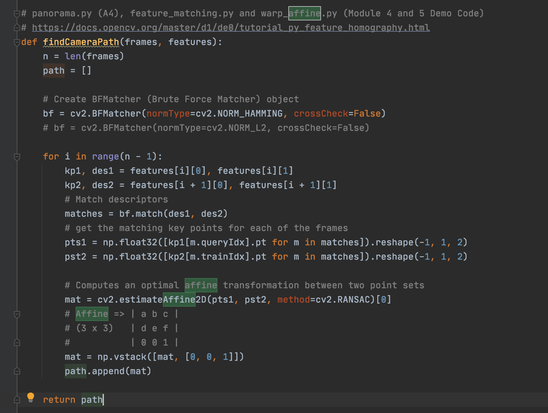
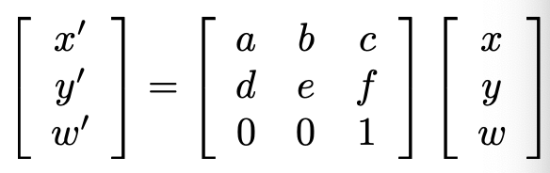
Find Original Camera Path
To find the camera path, I need to find the transformation between each frame, frame 1 to n. First, I need to extract features (key points and descriptors) from each frame using the extractFeatures() function and ORB detector. Those features are then pass into the findCameraPath() function. This function compare every two adjacent frames to find the affine transformation, homography, between them.
Affine Transformation
References:
Module 4 and 5 Demo Code – feature detection, feature matching, and image transforms
A3 – Panorama
https://docs.opencv.org/master/dc/dc3/tutorial_py_matcher.html
https://docs.opencv.org/master/d1/de0/tutorial_py_feature_homography.html

Slide 17
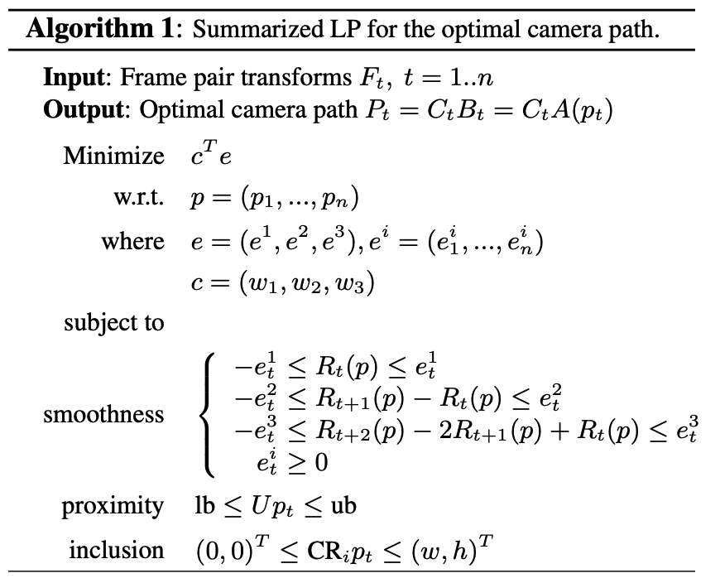
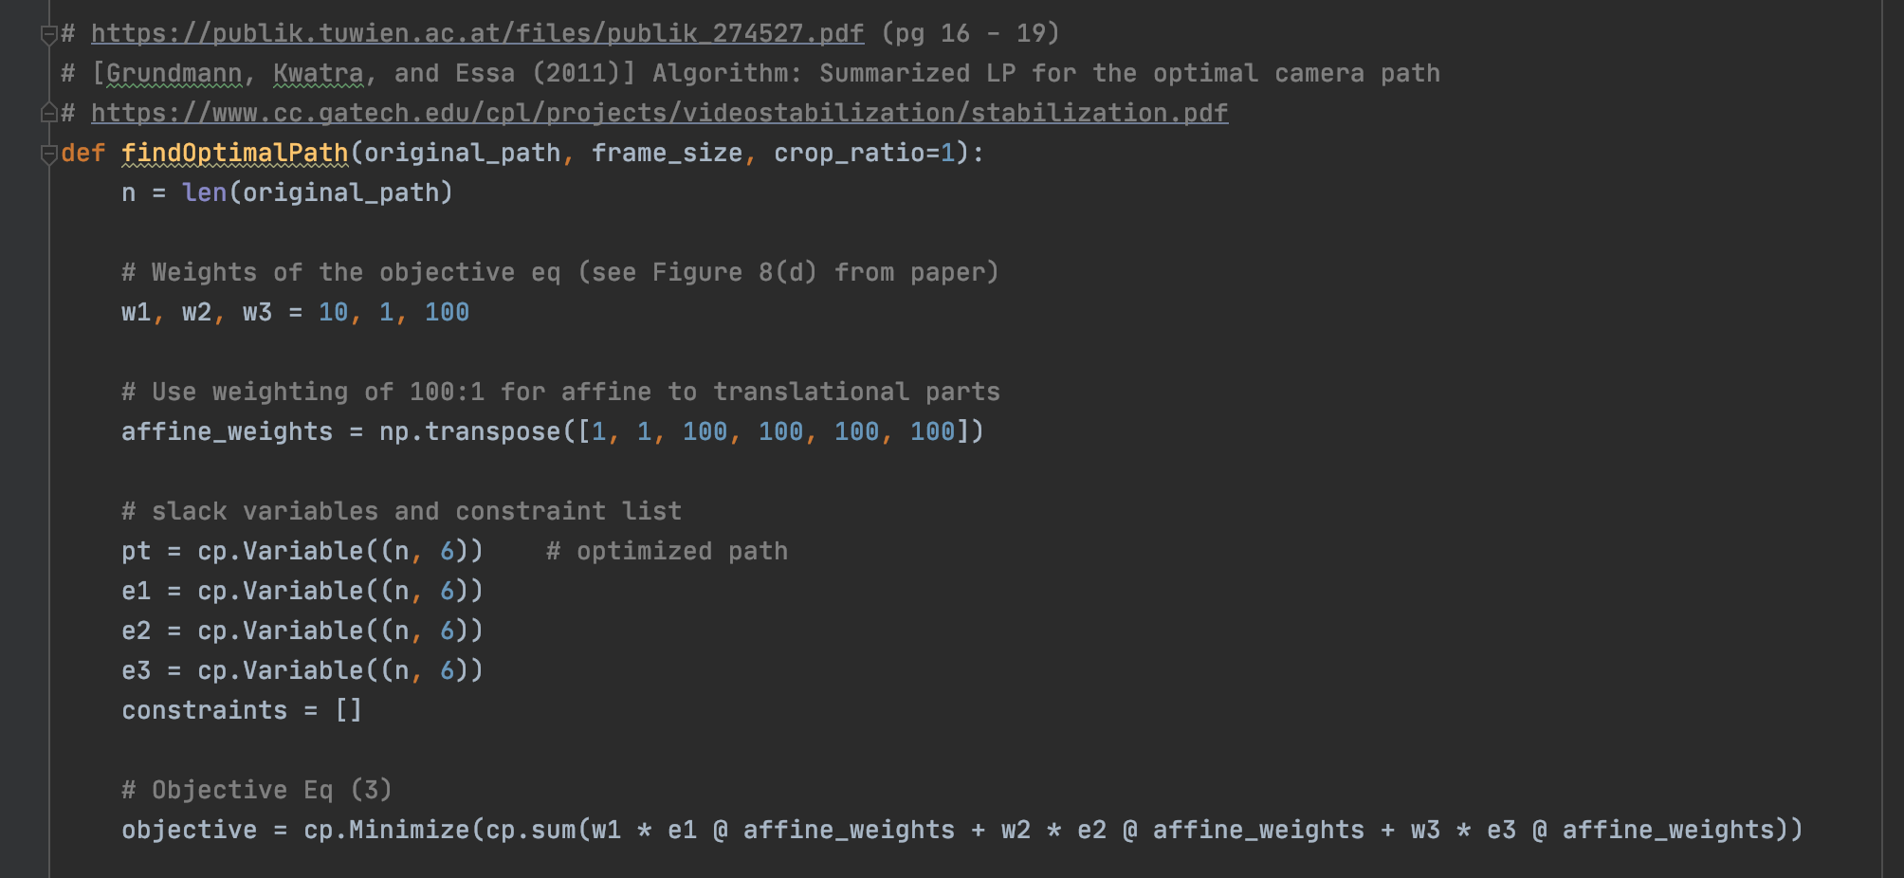
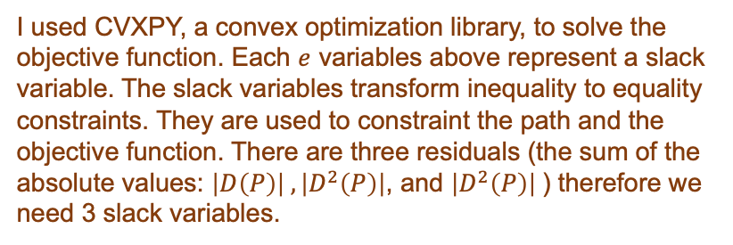
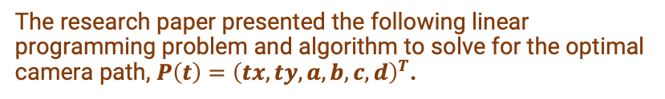
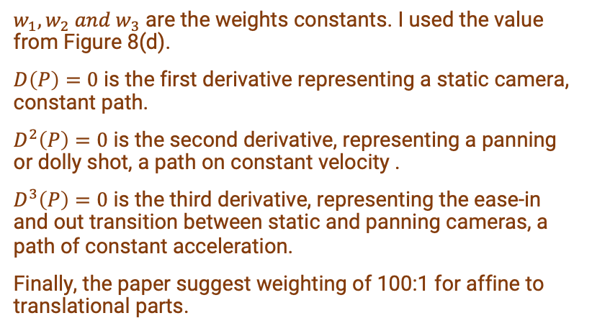
Find Optimal Path - Setup and Objective
The research paper presented the following linear programming problem and algorithm to solve for the optimal camera path, $P\left(t\right)={\left(tx, ty, a, b, c, d\right)}^{T}$.
Objective function:
$w_{1},w_{2} and w_{3}$ are the weights constants. I used the value from Figure 8(d).
$D\left(P\right)=0$ is the first derivative representing a static camera, constant path.
$D^{2}\left(P\right)=0$ is the second derivative, representing a panning or dolly shot, a path on constant velocity .
$D^{3}\left(P\right)=0$ is the third derivative, representing the ease-in and out transition between static and panning cameras, a path of constant acceleration.
Finally, the paper suggest weighting of 100:1 for affine to translational parts.
I used CVXPY, a convex optimization library, to solve the objective function. Each $e$ variables above represent a slack variable. The slack variables transform inequality to equality constraints. They are used to constraint the path and the objective function. There are three residuals (the sum of the absolute values: $\left|D\left(P\right)\right| ,\left|D^{2}\left(P\right)\right|$, and $\left|D^{2}\left(P\right)\right|$) therefore we need 3 slack variables.
References:
https://publik.tuwien.ac.at/files/publik_274527.pdf (Chapter 3, pg 16 - 19)
https://www.cc.gatech.edu/cpl/projects/videostabilization/stabilization.pdf
https://www.cvxpy.org/examples/basic/linear_program.html

Slide 18
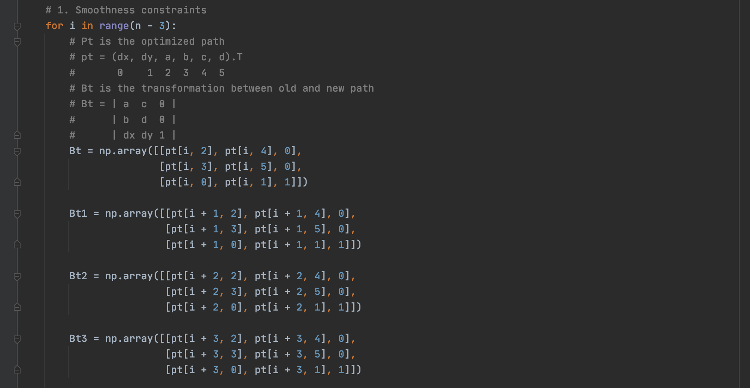
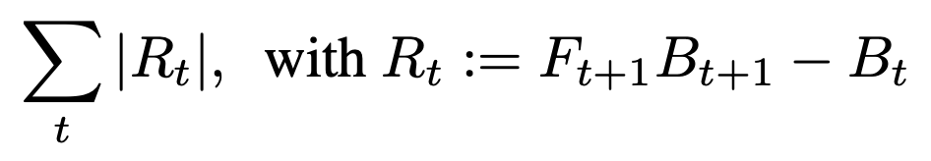
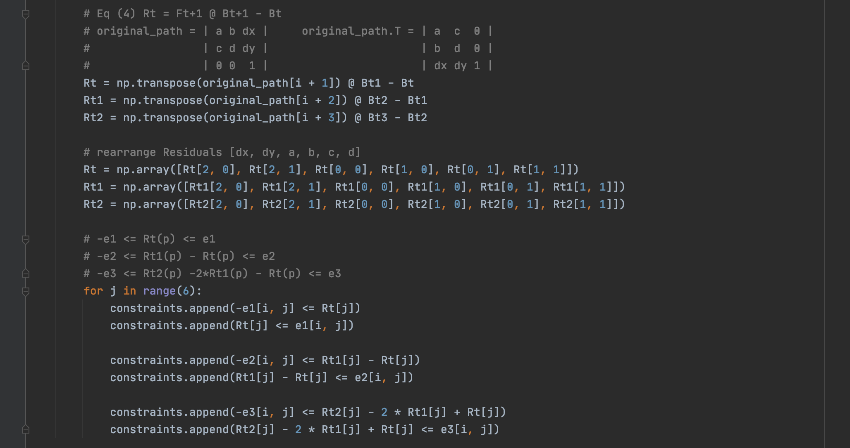
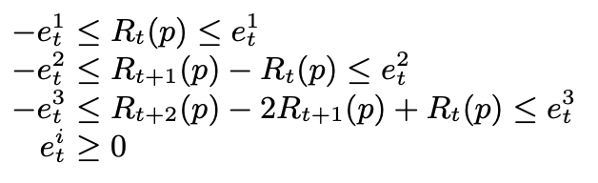
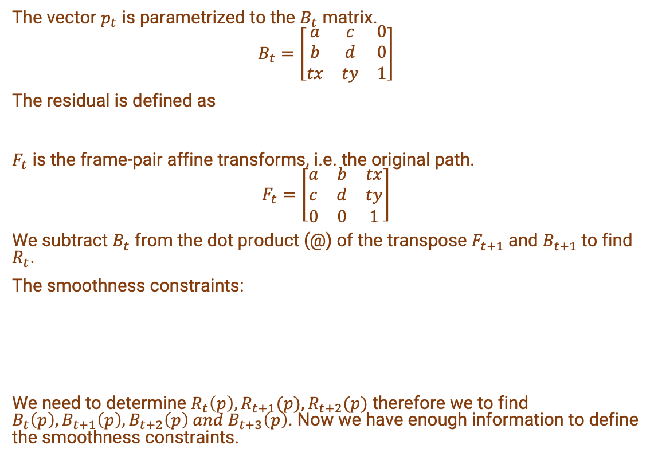
Find Optimal Path – Smoothness constraints
The vector $p_{t}$ is parametrized to the $B_{t}$ matrix.
$$B_{t}=\left[\begin{matrix}a & c & 0 \\ b & d & 0 \\ tx & ty & 1\end{matrix}\right]$$
The residual is defined as
$F_{t}$ is the frame-pair affine transforms, i.e. the original path.
$$F_{t}=\left[\begin{matrix}a & b & tx \\ c & d & ty \\ 0 & 0 & 1\end{matrix}\right]$$
We subtract $B_{t}$ from the dot product (@) of the transpose $F_{t+1}$and $B_{t+1}$to find $R_{t}$.
The smoothness constraints:
We need to determine $R_{t}\left(p\right), R_{t+1}(p),R_{t+2}(p)$ therefore we to find $B_{t}\left(p\right), B_{t+1}\left(p\right),B_{t+2}\left(p\right) and{ B}_{t+3}\left(p\right)$. Now we have enough information to define the smoothness constraints.
References:
https://publik.tuwien.ac.at/files/publik_274527.pdf (Chapter 3, pg 16 - 19)
https://www.cc.gatech.edu/cpl/projects/videostabilization/stabilization.pdf
https://www.cvxpy.org/examples/basic/linear_program.html

Slide 19
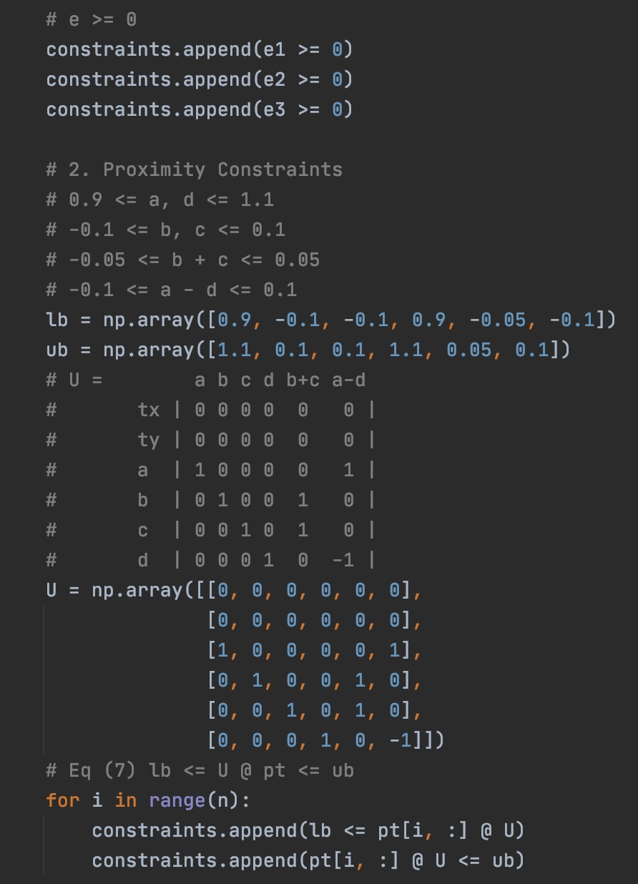
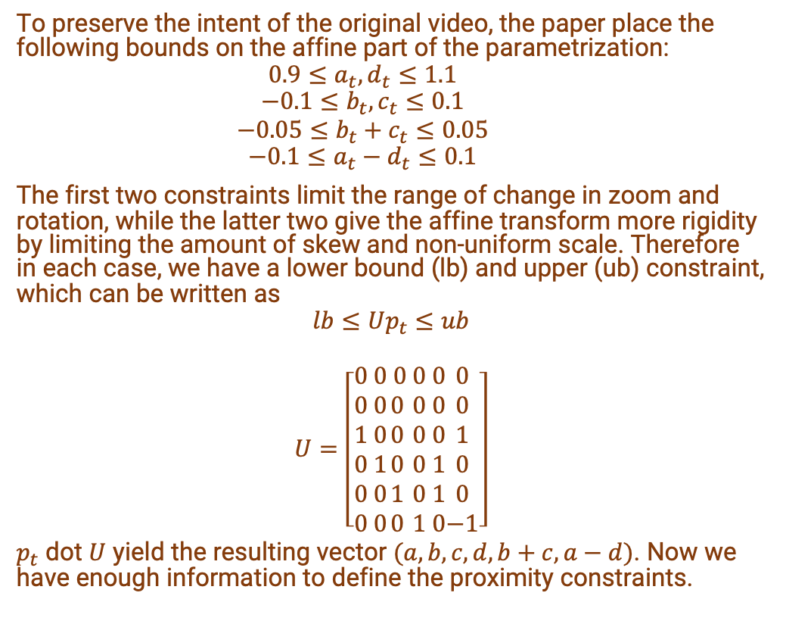
Find Optimal Path – Proximity constraints
To preserve the intent of the original video, the paper place the following bounds on the affine part of the parametrization:
$$0.9≤a_{t}, d_{t}≤1.1$$
$$−0.1≤b_{t}, c_{t}≤0.1$$
$$−0.05≤b_{t}+c_{t}≤0.05$$
$$−0.1≤a_{t}−d_{t}≤0.1$$
The first two constraints limit the range of change in zoom and rotation, while the latter two give the affine transform more rigidity by limiting the amount of skew and non-uniform scale. Therefore in each case, we have a lower bound (lb) and upper (ub) constraint, which can be written as
$$lb≤Up_{t}≤ub$$
$$U=\left[\begin{aligned}0 \\ 0 \\ 1 \\ 0 \\ 0 \\ 0\end{aligned} \begin{aligned}0 \\ 0 \\ 0 \\ 1 \\ 0 \\ 0\end{aligned}\begin{aligned} 0 \\ 0 \\ 0 \\ 0 \\ 1 \\ 0\end{aligned}\begin{aligned}0 \\ 0 \\ 0 \\ 0 \\ 0 \\ 1\end{aligned}\begin{aligned}0 \\ 0 \\ 0 \\ 1 \\ 1 \\ 0\end{aligned}\begin{aligned}0 \\ 0 \\ 1 \\ 0 \\ 0 \\ −1\end{aligned}\right]$$
$p_{t}$ dot $U$ yield the resulting vector $(a,b,c,d,b+c, a−d)$. Now we have enough information to define the proximity constraints.
References:
https://publik.tuwien.ac.at/files/publik_274527.pdf (Chapter 3, pg 16 - 19)
https://www.cc.gatech.edu/cpl/projects/videostabilization/stabilization.pdf
https://www.cvxpy.org/examples/basic/linear_program.html

Slide 20
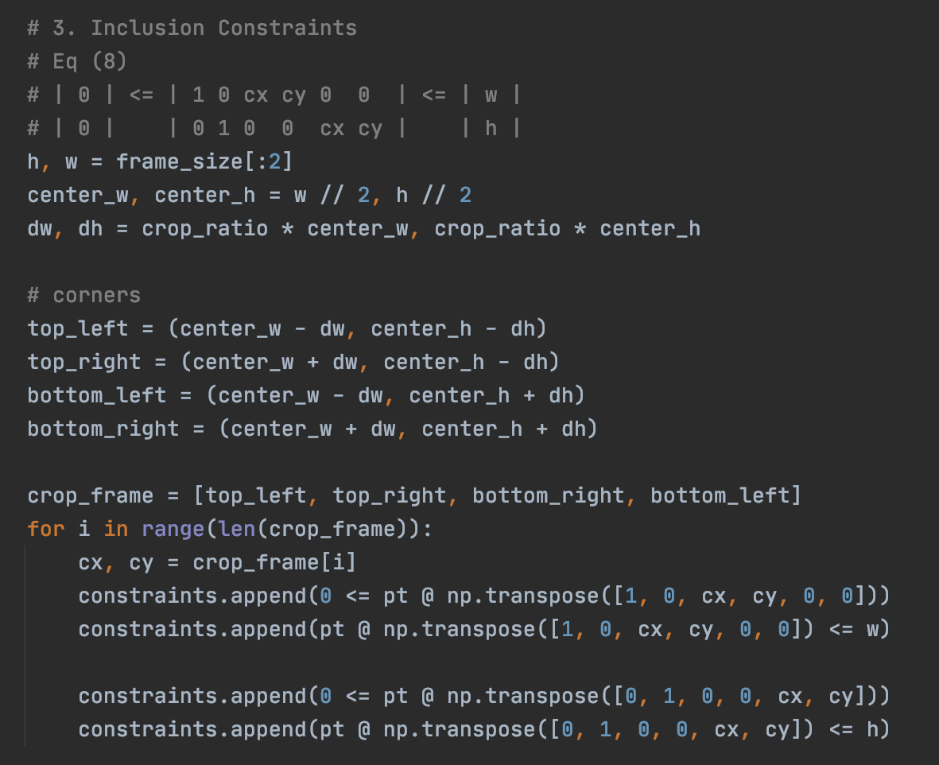
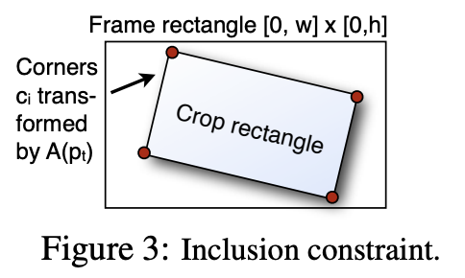
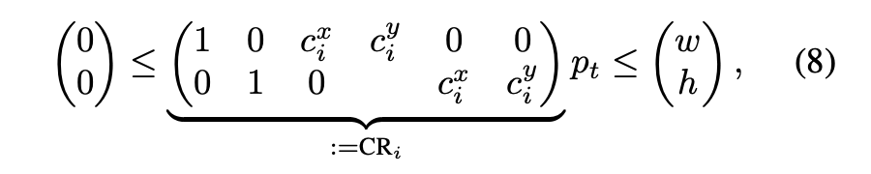
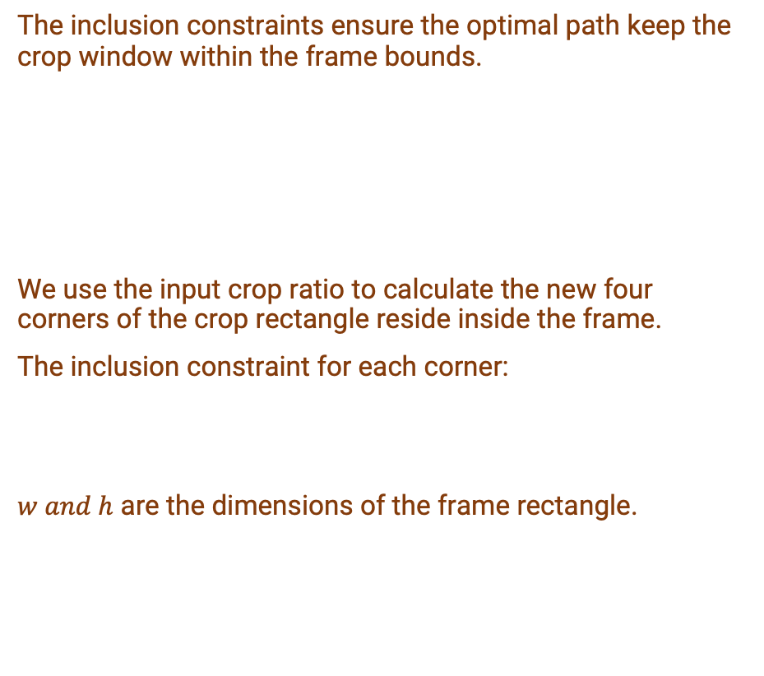
Find Optimal Path – Inclusion constraints
The inclusion constraints ensure the optimal path keep the crop window within the frame bounds.
We use the input crop ratio to calculate the new four corners of the crop rectangle reside inside the frame.
The inclusion constraint for each corner:
$w and h$ are the dimensions of the frame rectangle.
References:
https://publik.tuwien.ac.at/files/publik_274527.pdf (Chapter 3, pg 16 - 19)
https://www.cc.gatech.edu/cpl/projects/videostabilization/stabilization.pdf
https://www.cvxpy.org/examples/basic/linear_program.html

Slide 21
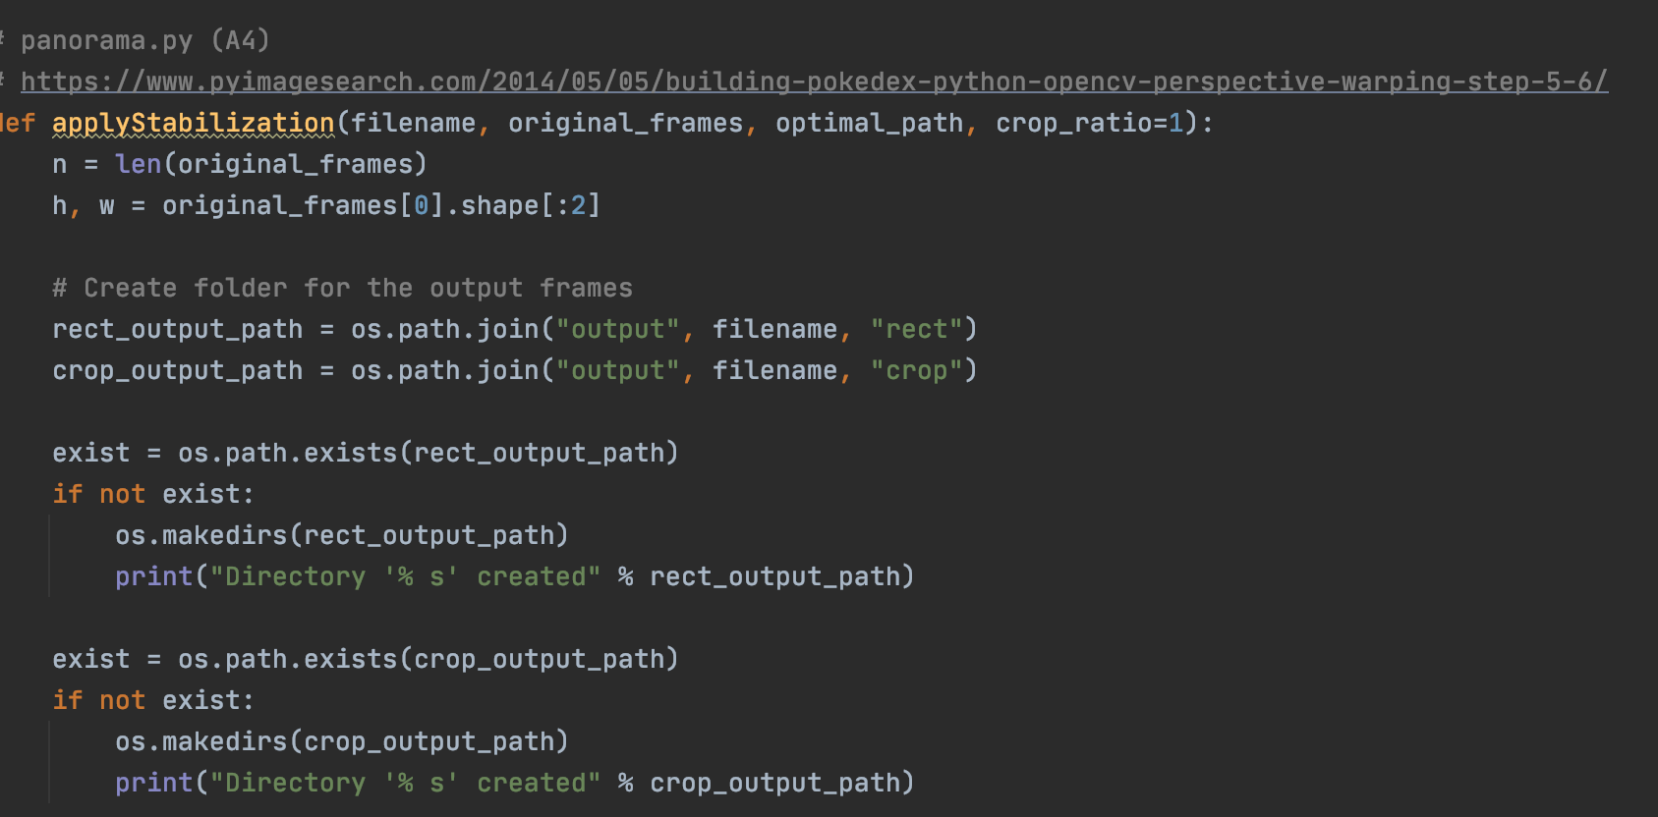
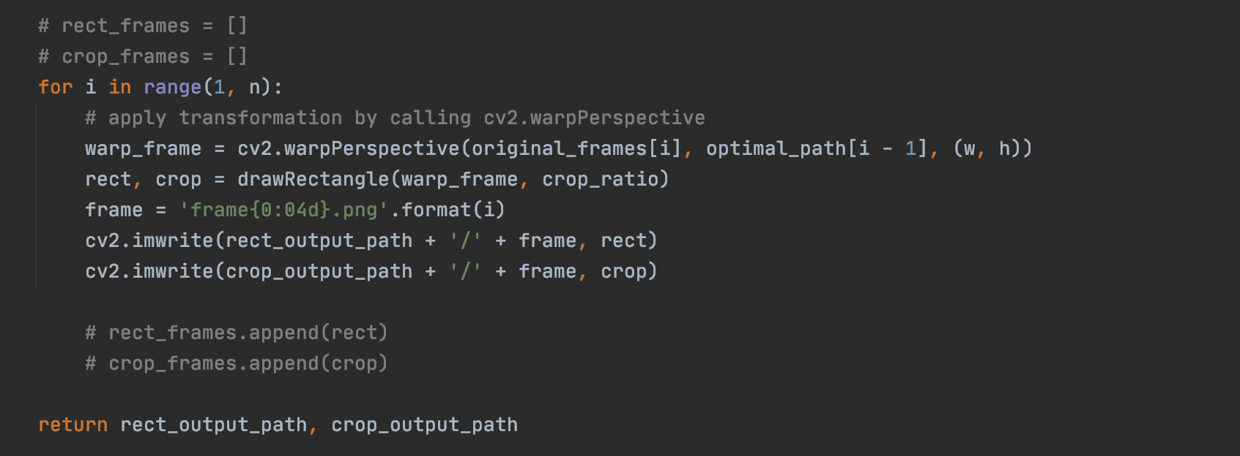
Apply Stabilization
Finally, I used cv2.warpPerspective() to apply the transformation, the optimal path, on to the original frames.
I didn’t have enough time to finalize how to warp the corners of the new crop frames. Given more time I would calculate the new crop corners of the optimal path and use cv2.findHomography() to transform the perspective of the corners, like what we did in A3 – Panorama.
References:
A3 – Panorama
https://www.pyimagesearch.com/2014/05/05/building-pokedex-python-opencv-perspective-warping-step-5-6/

Slide 22
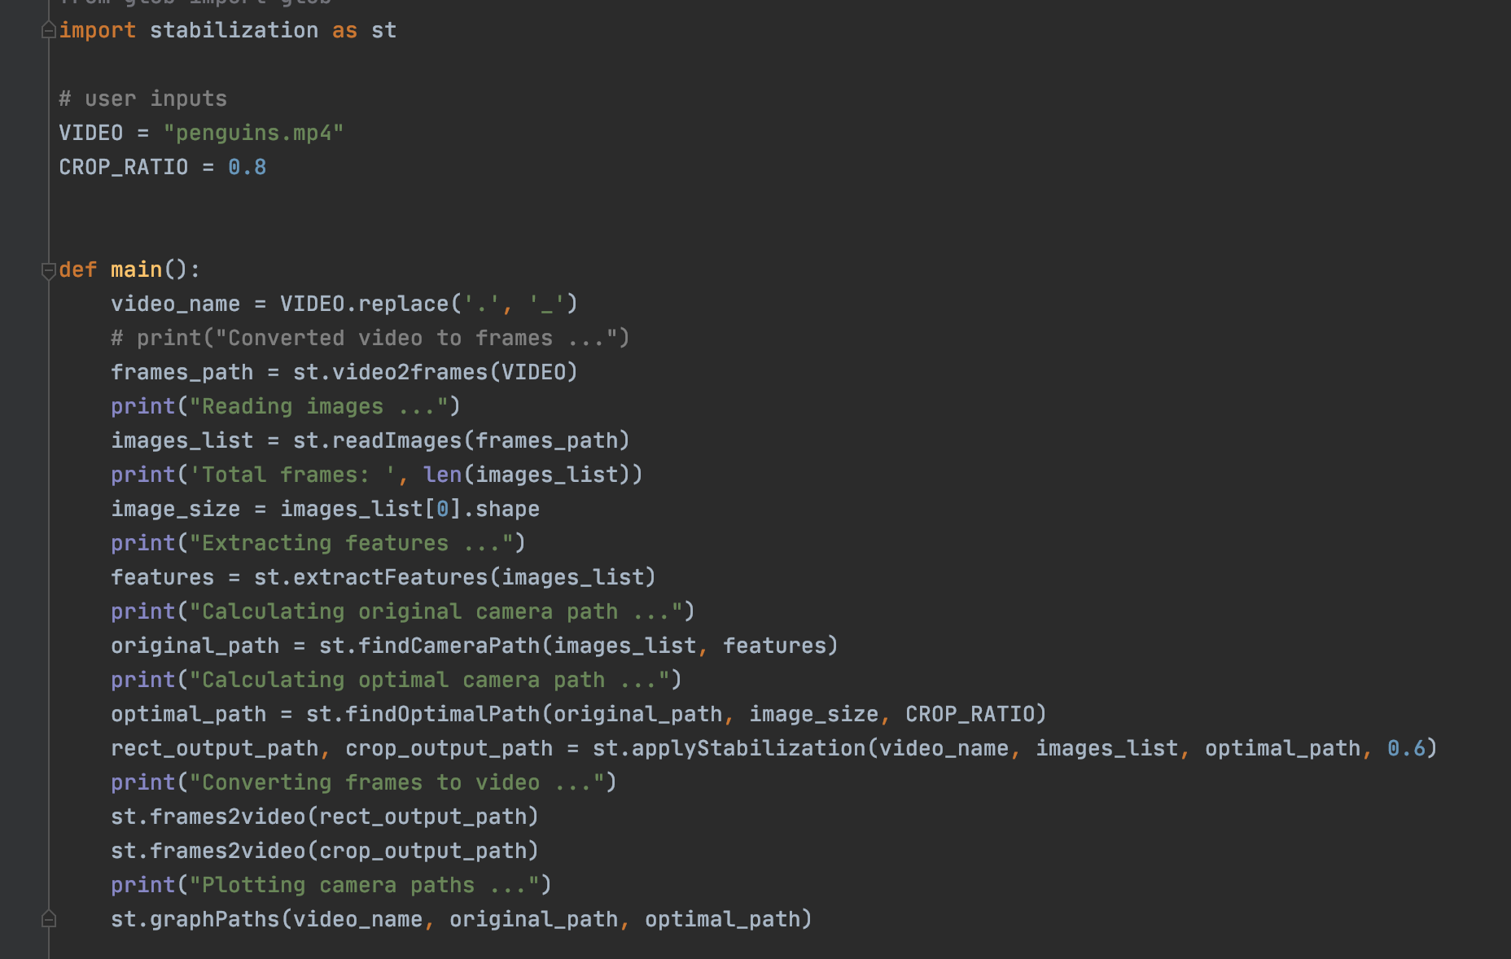
Main
Putting everything together:

Slide 23
Descriptions of libraries/packages
OS - The OS module in python provides functions for interacting with the operating system. I used this module to run the command line code in video2frames() and frames2video() function in stabilization.py
Numpy - NumPy is a Python library used for working with arrays and matrices. NumPy stands for Numerical Python.
CV2 – OpenCV is a library of Python bindings designed to solve computer vision problems. I used to find matching features and computing affine transform.
Glob - This module is useful in any situation where the program needs to look for a list of files on the filesystem with names matching a pattern.
Matplotlib - This is a comprehensive library for creating static, animated, and interactive visualizations in Python. I used to plot the motions over frames in the graphPaths() function.
CVXPY - Python-embedded modeling language for convex optimization problems. This library is heavily leverage in the findOptimalPath() to calculate the optimal path based on the algorithm presented In the paper.

Slide 24
List of Code Files
final_project.py (required)
This is the main file. Open this file to update user input, i.e. video filename, and run the code.
stabilization.py
This file contains all of the function definitions related to video stabilization.

Slide 25
Resources
Grundmann, Kwatra, and Essa (2011)
Algorithm: Summarized LP for the optimal camera path https://www.cc.gatech.edu/cpl/projects/videostabilization/stabilization.pdf
https://www.youtube.com/watch?v=QdXugkXBTbc&ab_channel=GoogleDevelopers
https://patentimages.storage.googleapis.com/a0/d1/f0/130ef429e3c974/US8531535.pdf
How to create a video from images with FFmpeg?
https://stackoverflow.com/questions/24961127/how-to-create-a-video-from-images-with-ffmpeg
OpenCV - Feature Matching, Feature Matching + Homography to find Objects
https://docs.opencv.org/master/dc/dc3/tutorial_py_matcher.html
https://docs.opencv.org/master/d1/de0/tutorial_py_feature_homography.html
Module 4 and 5 Demo Code – feature matching, feature detection, and image_transforms
A3 - Panorama
A5- Video Textures
Piazza @ 1072 Video Stabilization Discussion Thread
https://piazza.com/class/kdkh6c8vx7z5tf?cid=1072

Slide 26
Resources
Techniques for Improving Mobile Video Creation (pg 16 - 19) https://publik.tuwien.ac.at/files/publik_274527.pdf
Python OpenCV How to draw ractangle center of image and crop image inside rectangle? https://stackoverflow.com/questions/46795669/python-opencv-how-to-draw-ractangle-center-of-image-and-crop-image-inside-rectan/46803516
Building a Pokedex in Python: OpenCV and Perspective Warping https://www.pyimagesearch.com/2014/05/05/building-pokedex-python-opencv-perspective-warping-step-5-6/
Homography Examples using OpenCV
https://www.learnopencv.com/homography-examples-using-opencv-python-c/
Graph Plotting in Python https://www.geeksforgeeks.org/graph-plotting-in-python-set-1/
Matplotlib - Nan Test https://matplotlib.org/3.1.0/gallery/lines_bars_and_markers/nan_test.html#sphx-glr-gallery-lines-bars-and-markers-nan-test-py

Slide 27
Resources
The Youtube video of the skater
https://www.youtube.com/watch?v=2S_U1pnLE-M
Slack Variables
https://www.youtube.com/watch?v=ENEJnPTetBo&t=326s&ab_channel=MathFAQ
CVXPY - Robust Kalman filtering for vehicle tracking
https://www.cvxpy.org/examples/applications/robust_kalman.html
CVXPY - Linear program
https://www.cvxpy.org/examples/basic/linear_program.html
How can I safely create a nested directory?
https://stackoverflow.com/questions/273192/how-can-i-safely-create-a-nested-directory
Image Segmentation using OpenCV - Extracting specific Areas of an image
https://circuitdigest.com/tutorial/image-segmentation-using-opencv

